Slide 1
Machine Learning
Lecture 1: Introduction
Dr. Beilun Wang
Southeast University
School of Computer Science
and Engineering

Slide 2
Today
Course Logistics
Machine Learning Basics
Machine Learning History
A Rough Plan of Course Content

Slide 3
Requirements
Teacher: 王贝伦&刘胥影
Materials are mostly in English
Textbook:
Pattern Recognition and Machine Learning, ESL,
二班:《机器学习》
Contact details
E-mail:beilun@seu.edu.cn
QQ Group
Address:大学生活动中心513室

Slide 4
Requirements
Course credits & Assessment methods
Common 10% (check, course discussion)
Homework 10%(Math homework)
Final exam 60% ( closed-book examination)
Experiment 20 % ( programming homework, 6-8 times)
Extra point <= 5
Two extra rules:
Two absence => F
Final exam score == 100 => Final Score == 100

Slide 5
Today
Course Logistics
Machine Learning Basics
A Rough Plan of Course Content
Machine Learning History

Slide 6

OUR DATA-RICH WORLD
Biomedicine
Patient records, brain imaging, MRI & CT scans, …
Genomic sequences, bio-structure, drug effect info, …
Science
Historical documents, scanned books, databases from astronomy, environmental data, climate records, …
Social media
Social interactions data, twitter, facebook records, online reviews, …
Entertainment
Internet images, Hollywood movies, music audio files, …

Slide 7

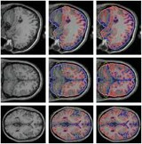
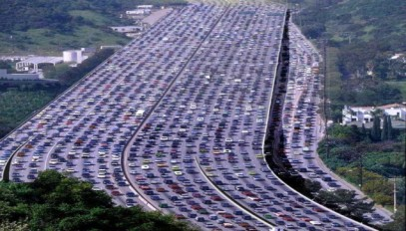
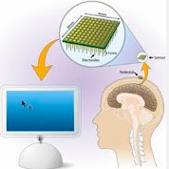
What can we do with the data wealth? → REAL-WORLD IMPACT
Business efficiencies
Scientific breakthroughs
Improve quality-of-life:
healthcare,
energy saving / generation,
environmental disasters,
nursing home,
transportation,
…
Genomic Data
Medical Images
Transportation Data
Brain computer interaction (BCI)

Slide 8



BIG DATA CHALLENGES
Data capturing (sensor, smart devices, medical instruments, et al.)
Data transmission
Data storage
Data management
High performance data processing
e.g. cloud computing
Data visualization
e.g. HCI
Data security & privacy (e.g. multiple individuals)
……
this
Data analytics
How can we analyze this big data wealth ?
E.g. Machine learning
course

Slide 9
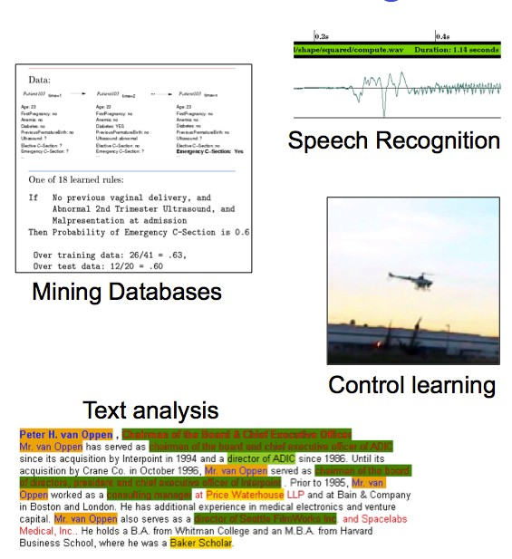
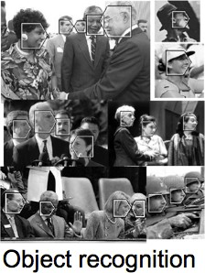
MACHINE LEARNING IS CHANGING THE WORLD
Many more !

Slide 10
BASICS OF MACHINE LEARNING
“The goal of machine learning is to build computer systems that can learn and adapt from their experience.” – Tom Dietterich
“Experience” in the form of available data examples (also called as instances, samples)
Available examples are described with properties (data points in feature space X)

Slide 11

e.g. SUPERVISED LEARNING
Find function to map input space X to output space Y
So that the difference between y and f(x) of each example x is small.
e.g.
x | I believe that this book is
not at all helpful since it does not explain thoroughly the material . it just provides the reader with tables and calculations that sometimes are not easily understood …
y
-1
Output Y: {1 / Yes , -1 / No }
e.g. Is this a positive product review ?
Input X : e.g. a piece of English text

Slide 12
SUPERVISED Linear Binary Classifier
Now let us check out a VERY SIMPLE case of
x
f
y
e.g.: Binary y / Linear f / X as R²
f(x,w,b) = sign(w^{T} x + b)
X =(x_1, x_2)

Slide 13
Traditional Programming
Data Program
Computer
Output
Machine Learning (training phase)
Data X Output Y
Computer
Program
/ Model f()

Slide 14

SUPERVISED Linear Binary Classifier
x
f
y
X_2
f(x,w,b) = sign(w^{T} x + b)
X =(x_1, x_2)
w^{T}x + b>0
“Predict Class = +1”
x + b=0
zone
T
w
denotes +1 point
denotes -1 point
“Predict Class = -1”
zone
w^{T} x + b<0
x_1
Courtesy slide from Prof. Andrew Moore’s tutorial

Slide 15
SUPERVISED Linear Binary Classifier
x
f
y
X_2
?
f(x,w,b) = sign(w^{T} x + b)
X =(x_1, x_2)
w^{T}x + b>0
“Predict Class = +1”
?
x + b=0
zone
T
w
denotes +1 point
denotes -1 point
denotes future points
“Predict Class = -1”
?
zone
w^{T} x + b<0
x_1
Courtesy slide from Prof. Andrew Moore’s tutorial

Slide 16
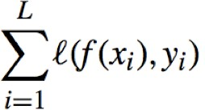
Basic Concepts
Training (i.e. learning parameters w,b )
Training set includes
available examples x₁,…,x_{L}
available corresponding labels y₁,…,y_{L}
Find (w,b) by minimizing loss
(i.e. difference between y and f(x) on available examples in training set)
(W, b) = argmin
W, b

Slide 17
Basic Concepts
Testing (i.e. evaluating performance on “future”
points)
Difference between true y? and the predicted f(x?) on a set of testing examples (i.e. testing set)
Key: example x? not in the training set
Generalisation: learn function / hypothesis from past data in order to “explain”, “predict”, “model” or “control” new data examples

Slide 18
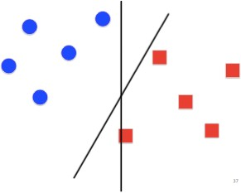
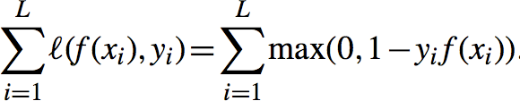

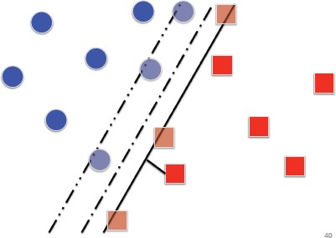

Basic Concepts
Loss function
e.g. hinge loss for binary classification task
e.g. pairwise ranking loss for ranking task (i.e. ordering examples by preference)
Regularization
E.g. additional information added on loss function to control f

Slide 19
Machine Learning in a Nutshell
Task
Representation
Score Function Search/Optimization
Models, Parameters
ML grew out of work in AI
Optimize a performance criterion using example data or past experience,
Aiming to generalize to unseen data

Slide 20
Today
Course Logistics
Machine Learning Basics
Machine Learning History
A Rough Plan of Course Content

Slide 21
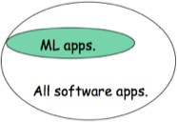
MACHINE LEARNING IN COMPUTER SCIENCE
Machine learning is already the preferred approach for
Speech recognition, natural language processing
Computer vision
Medical outcome analysis
Robot control …
Why growing ?
Improved machine learning algorithms
Improved CPU / GPU powers
Increased data capture, new sensors, networking
Systems/Software too complex to control manually
Demand to self-customization for user, environment, ….

Slide 22
HISTORY OF MACHINE LEARNING
1950s
Samuel’s checker player
Selfridge’s Pandemonium
1960s:
Neural networks: Perceptron
Pattern recognition
Learning in the limit theory
Minsky and Papert prove limitations of Perceptron
1970s:
Symbolic concept induction
Winston’s arch learner
Expert systems and the knowledge acquisition bottleneck
Quinlan’s DT ID3
Michalski’s AQ and soybean diagnosis
Scientific discovery with BACON
Mathematical discovery with AM
Adapted from Prof. Raymond J. Mooney’s slides

Slide 23
HISTORY OF MACHINE LEARNING
1980s:
Advanced decision tree and rule learning
Explanation-based Learning (EBL)
Learning and planning and problem solving
Utility problem
Analogy
Cognitive architectures
Resurgence of neural networks (connectionism, backpropagation)
Valiant’s PAC Learning Theory
Focus on experimental methodology
1990s
Data mining
Adaptive software agents and web applications
Text learning
Reinforcement learning (RL)
Inductive Logic Programming (ILP)
Ensembles: Bagging, Boosting, and Stacking
Bayes Net learning
Adapted from Prof. Raymond J. Mooney’s slides

Slide 24
HISTORY OF MACHINE LEARNING
2000s
Support vector machines
Kernel methods
Graphical models
Statistical relational learning
Transfer learning
Sequence labeling
Collective classification and structured outputs
Computer Systems Applications
Compilers
Debugging
Graphics
Security (intrusion, virus, and worm detection)
Email management
Personalized assistants that learn
Learning in robotics and vision
Adapted from Prof. Raymond J. Mooney’s slides

Slide 25
HISTORY OF MACHINE LEARNING
2010s
Speech translation, voice recognition (e.g. SIRI)
Google search engine uses numerous machine learning techniques (e.g. grouping news, spelling corrector, improving search ranking, image retrieval, …..)
23 and me (scan sample of person genome, predict likelihood of genetic disease, … )
DeepMind, Google Brain, …
IBM waston QA system
Machine Learning as a service (e.g. google prediction API, bigml.com, cloud autoML . )
IBM healthcare analytics
……
Adapted from Prof. Raymond J. Mooney’s slides

Slide 26
RELATED DISCIPLINES
Artificial Intelligence
Data Mining
Probability and Statistics
Information theory
Numerical optimization
Computational complexity theory
Control theory (adaptive)
Psychology (developmental, cognitive)
Neurobiology
Linguistics
Philosophy

Slide 27




What are the goals of AI research?
Artifacts that ACT RATIONALLY
Artifacts that ACT like HUMANS
Artifacts that THINK like HUMANS
From: M.A. Papalaskar

Slide 28


Reason of the recent breakthroughs:
Advanced Computer Architecture that fits DNNs
Plenty of (Labeled) Data
Powerful DNN platforms / Libraries

Slide 29
Today
Course Logistics
Machine Learning Basics
Machine Learning History
A Rough Plan of Course Content

Slide 30
Traditional Programming
Data Program
Computer
Output
Machine Learning (training phase)
Data X Output Y
Computer
Program
/ Model f()

Slide 31

TYPICAL MACHINE LEARNING Pipeline
(Learning Mode)
Low-level sensing
Pre- processing
Feature Extract
Feature Select
Inference, Prediction, Recognition
Label Collection
Evaluation

Slide 32
TYPICAL MACHINE LEARNING Pipeline
(Learning Mode)
Data Complexity of X
Low-level sensing
Pre- processing
Feature Extract
Feature Select
Inference, Prediction, Recognition
Data Complexity of Y
Label Collection
Evaluation

Slide 33





UNSUPERVISED LEARNING :
[ COMPLEXITY in Y ]
No labels are provided (e.g. No Y provided)
Find patterns from unlabeled data, e.g. clustering
e.g. clustering => to find “natural” grouping of instances given un-labeled data

Slide 34

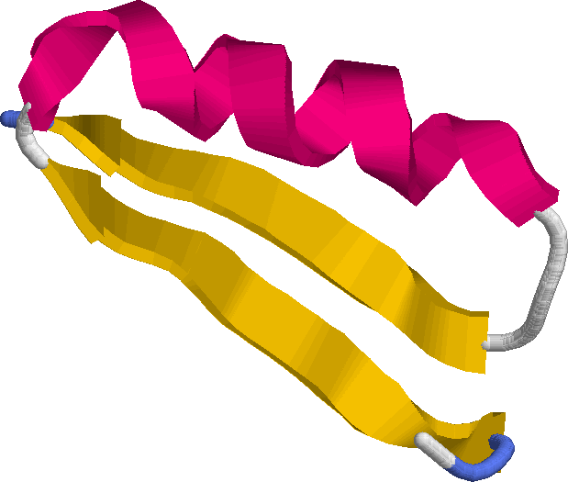
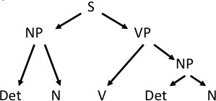
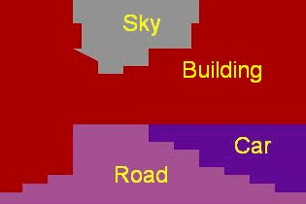
STRUCTURAL OUTPUT LEARNING :
[ COMPLEXITY OF Y ]
Many prediction tasks involve output labels having structured correlations or constraints among instances
Structured Dependency between Examples’ Y
Sequence
Grid
Tree
Input
The dog chased the cat
APAFSVSPASGACGPECA…
Output
CCEEEEECCCCCHHHCCC…
Many more possible structures between y_i , e.g. spatial , temporal, relational …

Slide 35
STRUCTURAL INPUT : Kernel Methods
[ COMPLEXITY OF X ]
Ø
Ø
e.g. Graphs, Sequences, 3D structures,
Ø
Original Space
Feature Space

Slide 36
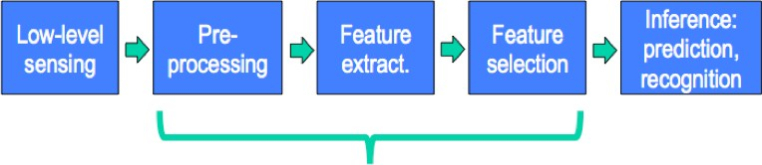
DEEP LEARNING / FEATURE LEARNING :
Feature Engineering
Most critical for accuracy
Account for most of the computation for testing
Most time-consuming in development cycle
Often hand-craft and task dependent in practice
Feature Learning
Easily adaptable to new similar tasks
Layerwise representation
Layer-by-layer unsupervised training
Layer-by-layer supervised training

Slide 37
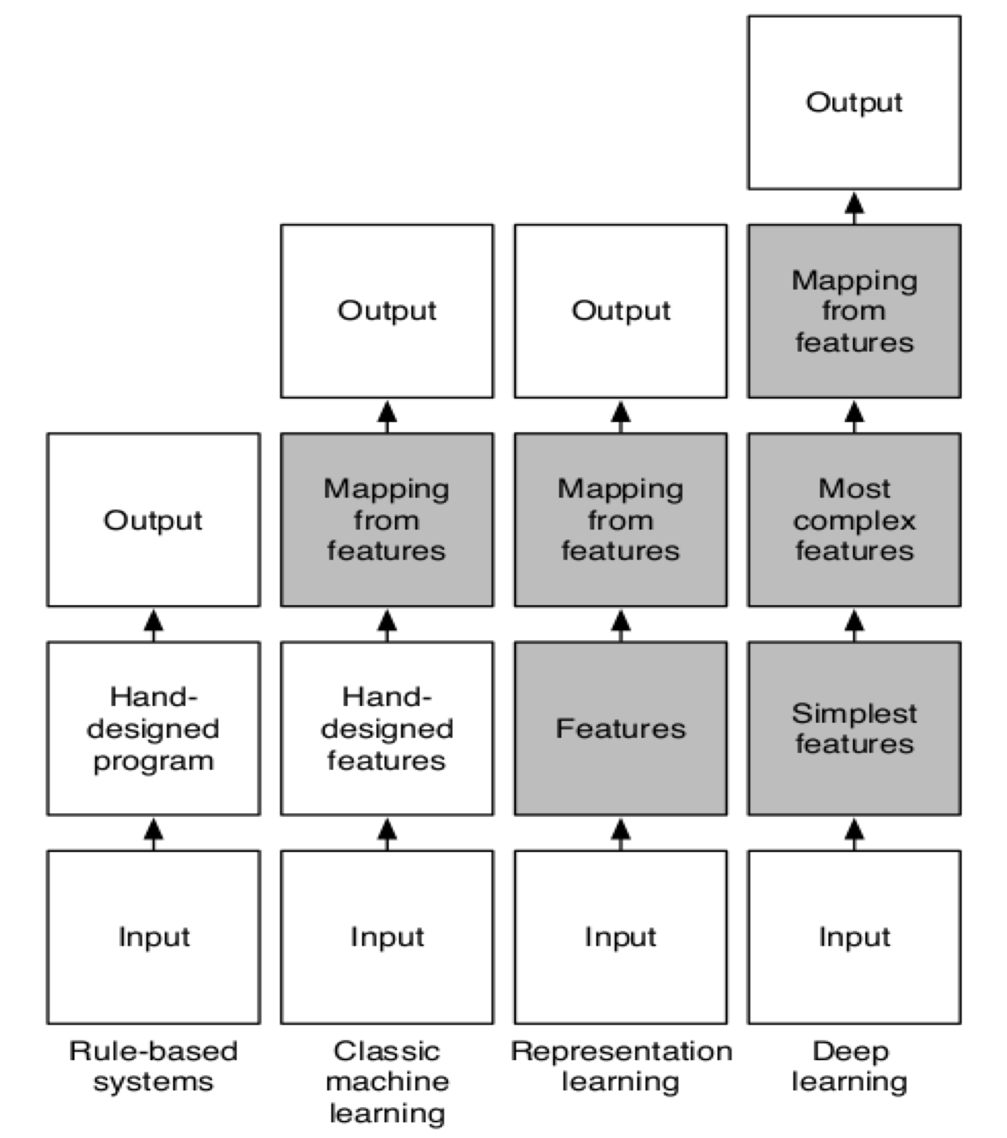
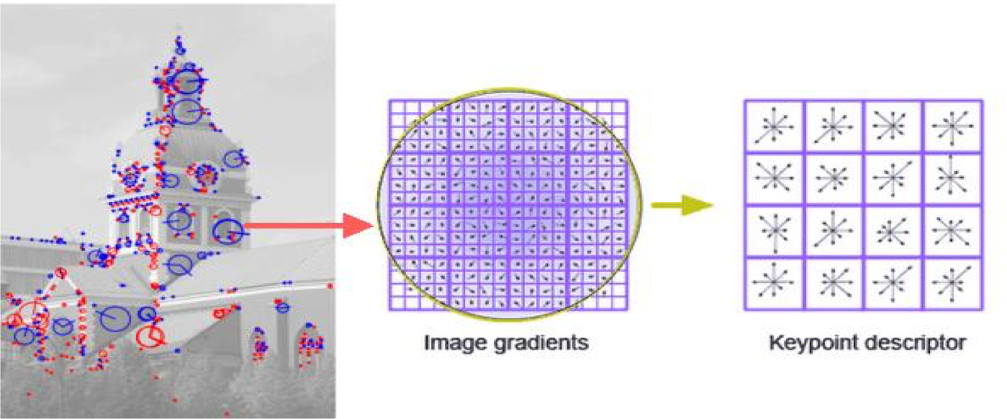
Why learn features?
34

Slide 38
Reinforcement Learning (RL)
[ COMPLEXITY OF (X,Y) ]
What’s Reinforcement Learning?
Environment
{Observation, Reward}
{Actions}
Agent
Agent interacts with an environment and learns by maximizing a scalar reward signal
Basic version: No labels or any other supervision signal.
Variation like imitation learning: supervised
Previously suffering from hand-craft states or representation
Adapt from Professor Qiang Yang of HK UST

Slide 39
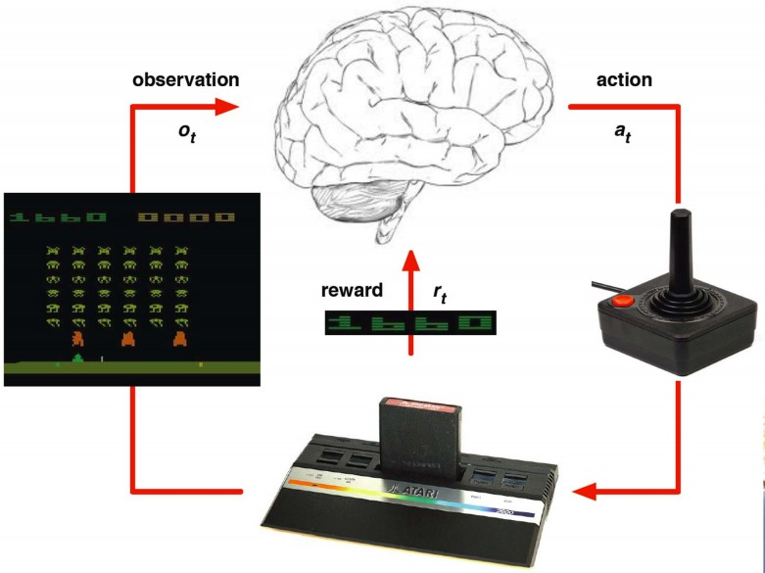
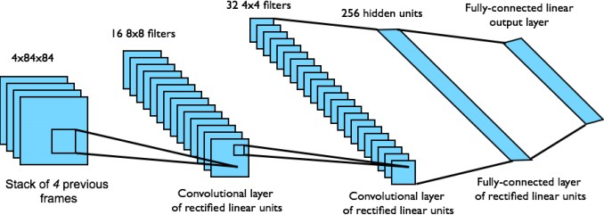
Deep Reinforcement Learning
[ COMPLEXITY OF (X,Y) ]
Human
So what’s DEEP RL?
Environment
{Raw Observation, Reward}
{Actions}
Adapt from Professor Qiang Yang of HK UST

Slide 40
When to use Machine Learning (Adapt to / learn from data) ?
1. Extract knowledge from data
Relationships and correlations can be hidden within large amounts of data
The amount of knowledge available about certain tasks is simply too large for explicit encoding (e.g. rules) by humans
2. Learn tasks that are difficult to formalise
Hard to be defined well, except by examples, e.g., face recognition
3. Create software that improves over time
New knowledge is constantly being discovered.
Rule or human encoding-based system is difficult to continuously re-design “by hand”.

Slide 41


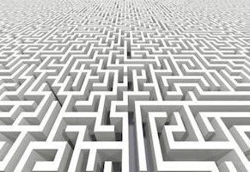

“Big Data” Challenges for Machine Learning
Large size of samples
High dimensional features
Not the focus, being covered in my advanced- level course

Slide 42
Large-Scale Machine Learning: SIZE MATTERS
One thousand data instances
One million data instances
One billion data instances
One trillion data instances
Those are not different numbers, those are different mindsets !!!

Slide 43
Course Content Plan ➔
Six major sections of this course
Regression (supervised)
Classification (supervised)
Unsupervised models
Learning theory
Y is a continuous
Y is a discrete
NO Y
About f()
Graphical models
Reinforcement Learning
About interactions among X1,… Xp
Learn program to Interacts with its environment

Slide 44
Machine Learning in a Nutshell
Task
Representation
Score Function Search/Optimization
Models, Parameters
ML grew out of work in AI
Optimize a performance criterion using example data or past experience,
Aiming to generalize to unseen data

Slide 45
What we have covered
Task Representation
Score Function
Search/Optimization
Models, Parameters

Slide 46
What we will cover
 | Task | Regression, classification, clustering, dimen-reduction
 | Representation | Linear func, nonlinear function (e.g. polynomial expansion), local linear, logistic function (e.g. p(c|x)), tree, multi-layer, prob-density family (e.g. Bernoulli, multinomial, Gaussian, mixture of Gaussians), local func smoothness, kernel matrix, local smoothness, partition of feature space,
 | Score Function | MSE, Margin, log-likelihood, EPE (e.g. L2 loss for KNN, 0-1 loss for Bayes classifier), cross-entropy, cluster points distance to centers, variance, conditional log-likelihood, complete data-likelihood, regularized loss func (e.g. L1, L2) , goodness of inter-cluster similar
 | Search/ Optimization | Normal equation, gradient descent, stochastic GD, Newton, Linear programming, Quadratic programming (quadratic objective with linear constraints), greedy, EM, asyn-SGD, eigenDecomp, backprop
 | Models, Parameters | Linear weight vector, basis weight vector, local weight vector, dual weights, training samples, tree-dendrogram, multi-layer weights, principle components, member (soft/hard) assignment, cluster centroid, cluster covariance (shape), …

Slide 47
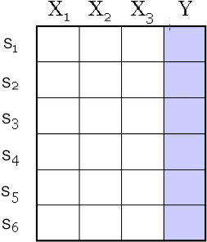
Data/points/instances/examples/samples/records: [ rows ]
Features/attributes/dimensions/independent
variables/covariates/predictors/regressors: [ columns, except the last]
Target/outcome/response/label/dependent variable: special column to be predicted [ last column ]

Slide 48
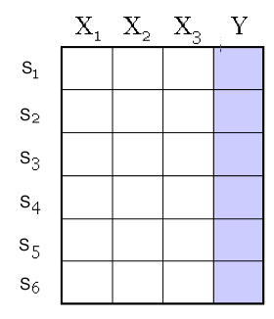
Main Types of Columns
Continuous: a real number, for example, weight
Discrete: a symbol, like “Good” or “Bad”

Slide 49
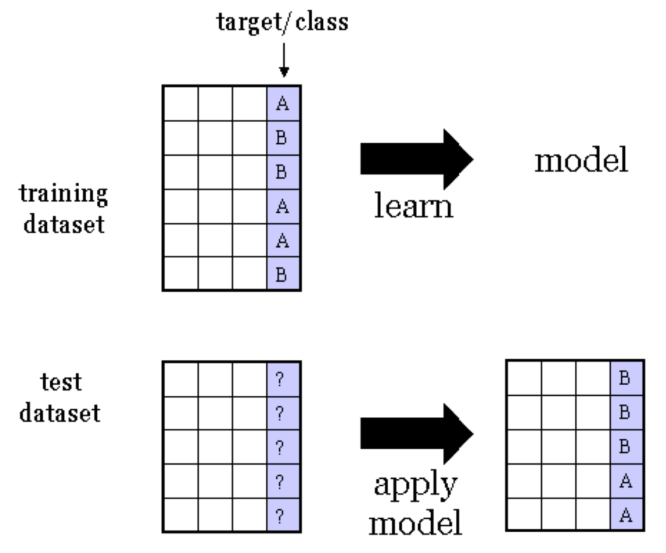

e.g. SUPERVISED Classification
Training dataset
consists of input-
output pairs
f(x?)
e.g. target Y can be a discrete target variable

Slide 50
e.g. SUPERVISED Regression
9
12.5
3
5
20
7
Training dataset
consists of input-
output pairs
f(x?)
e.g. target Y can be a continuous target variable
10
12
1
5
7

Slide 51

How to know the program works well?
Training dataset
consists of input-
output pairs
f(x?)
Evaluation
Measure Loss on pair
➔ Error ( f(x?), y? )

Slide 52
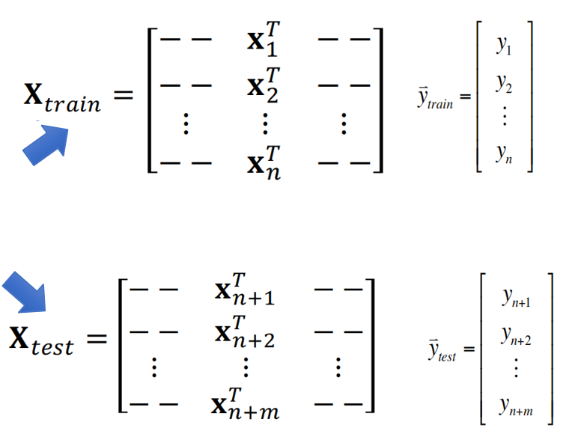

− − �* − −
− − , − −
! _{y} ∃
# &
# y₂ &
&
# &
&%
+
1
�+
!
�"#$%& ⁼
^{y}train ⁼ #
⋮ ⋮ ⋮
− − − −
"
�+
#″ y_{n}
&
− −
− −
⋮
− −
�+
− −
− −
⋮
− −
!
∃
&
&
&
&
y
&0*
#
n+1
�+
!
^{# y}n+2
�"./" ⁼
&0,
^{y}test ⁼ #
⋮
"
�+
#
^{# y}n+m
&
&01
″
%

Slide 53
Notation
Inputs
X_{j} (j-th element of a vector variable X ) : random variables written in capital letter
p #input variables, n #observations
X : matrix written in bold capital
Vectors are assumed to be column vectors
Discrete inputs often described by characteristic vector (dummy variables)
Outputs
quantitative Y
qualitative C (for categorical)
Observed written in lower case
The i-th observed sample of the random variable
X_{j} is x_{j,i} (a scalar)

Slide 54
References
Prof. Andrew Moore’s tutorials
Prof. Raymond J. Mooney’s slides
Prof. Alexander Gray’s slides
Prof. Eric Xing’s slides
http://scikit-learn.org/
Hastie, Trevor, et al. The elements of statistical learning. Vol. 2. No. 1. New York: Springer, 2009.
Prof. M.A. Papalaskar’s slides
https://qiyanjun.github.io/2019f-UVA-CS6316-MachineLearning/

